Slide 1


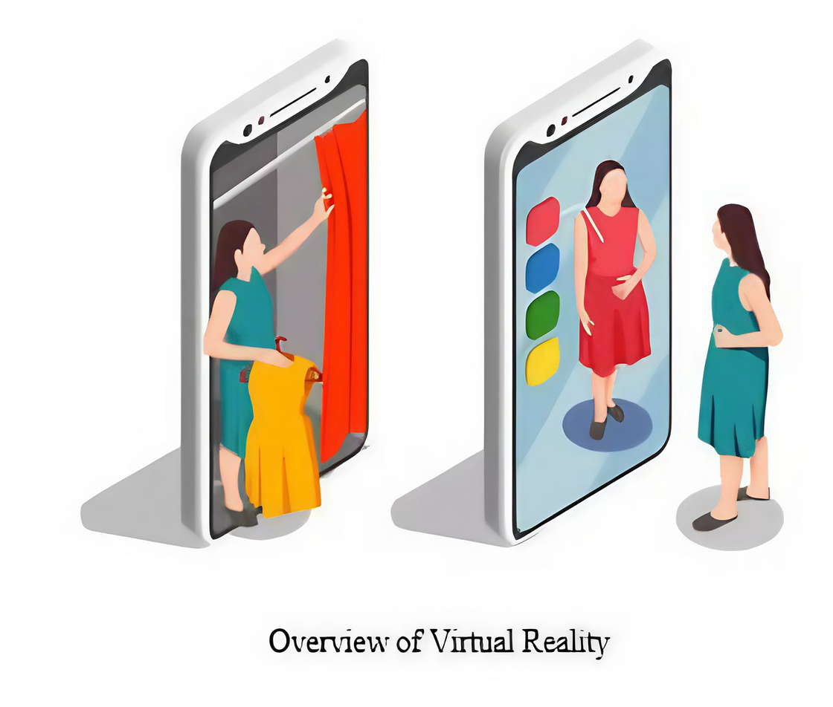


Try Fit
Virtual try-on Egyptian brands

Slide 2


Presented by
Genyveyav Raafat Louka
Toqa Osama Ali
Hassnaa Hassan Saied
Maria George Kamel
Habiba Mohammed Yahia
Monica Adel Lotfy
Supervised by
Prof.Dr. Abeer Mahmoud
TA. Mohamed Essam

Slide 3
TABLE OF CONTENT
Presented by
01
Introduction
06
Phases Description
02
Problem Definition & Motivation
07
Experimental Results
03
Objective
08
Demo
04
System Architecture
09
Conclusion & Future Work
05
Dataset
10
Refrences

Slide 4
1- Introduction

Slide 5

Introduction
TryFit is a multicategory project that brings together artificial intelligence, computer vision and fashion technology. It goes beyond traditional VTON by focusing on realistic garment fitting, cultural diversity and support for modest fashion.

Slide 6
2- Problem Definition and Motivation

Slide 7

Problem Definition
In Egypt’s growing online fashion market, many shoppers struggle to assess clothing fit, leading to high return rates. For veiled women and privacy-conscious users, the lack of virtual
try-on options adds to the difficulty. Going to stores is also time-consuming.
63%
online clothes refund rate

Slide 8
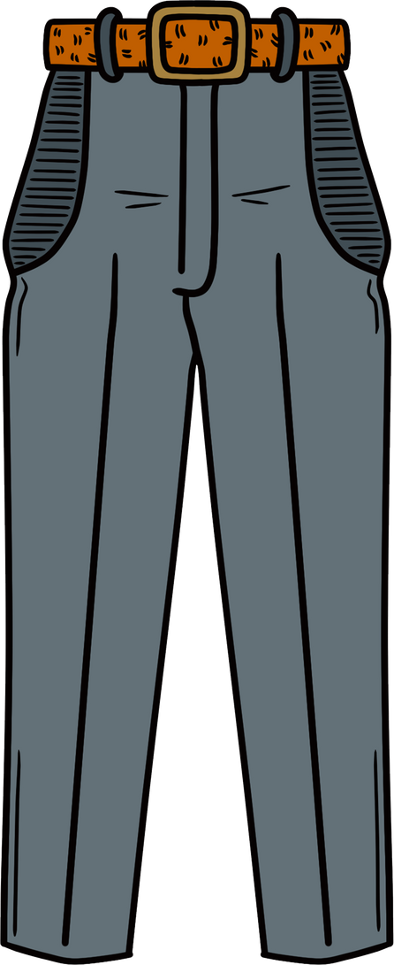
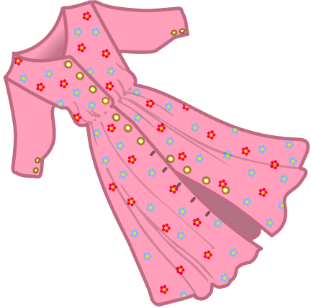
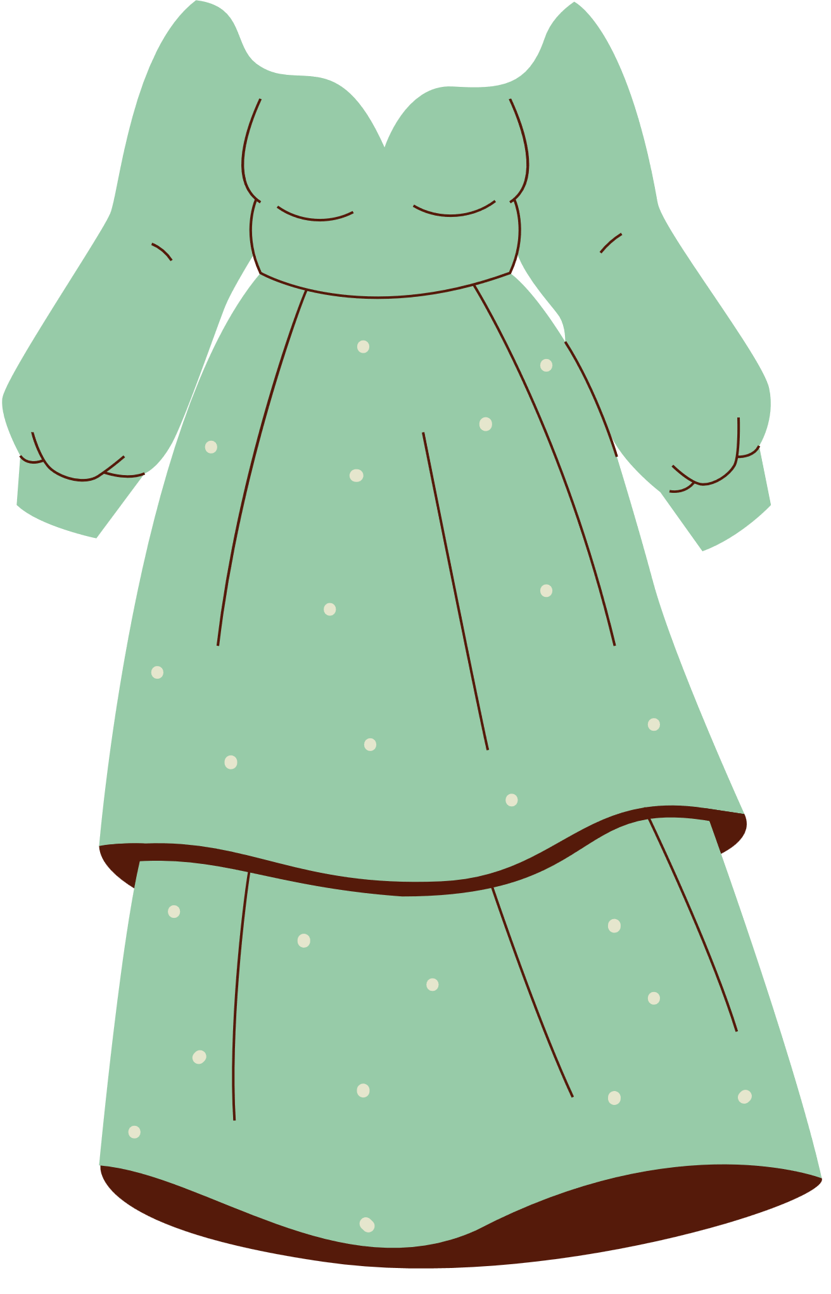
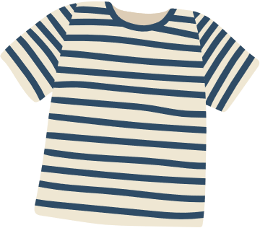
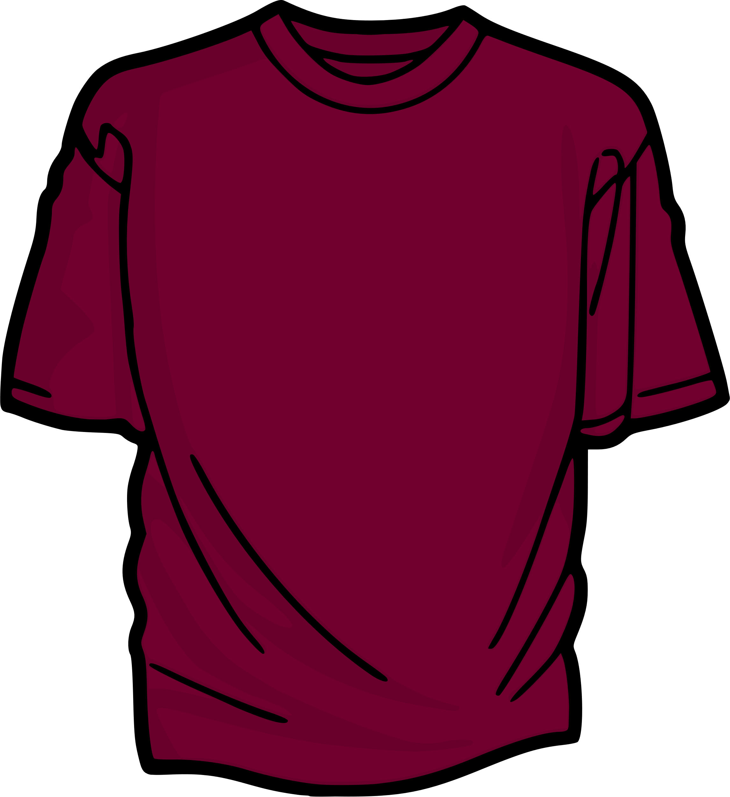
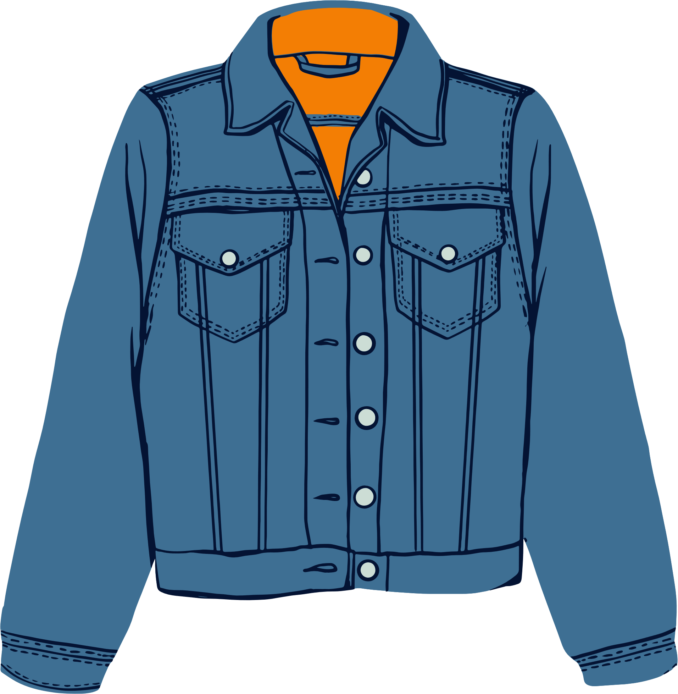
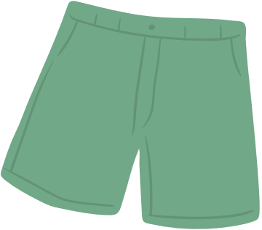
Motivation
Motivated by these challenges, our team set out to build a solution that not only improves fit accuracy but also respects cultural preferences and enhances the online shopping experience in a personalized and intelligent way.

Slide 9
3- Objective

Slide 10




Developing an AI-powered, Virtual Try-On (VTON) system
Culturally Inclusive Try-On
Designed with hijab integration for diverse and inclusive virtual fitting experiences.
Support Local & Regional Fashion
Built to promote Egyptian designers and showcase homegrown brands with regional styles.
Reduce Returns
Focused on realistic fit visualization to improve accuracy and trust in online shopping.
Easy-to-Use Interface
Simple browsing, selecting, and trying on clothes with a seamless user-friendly design.

Slide 11
4- System Architecture

Slide 12
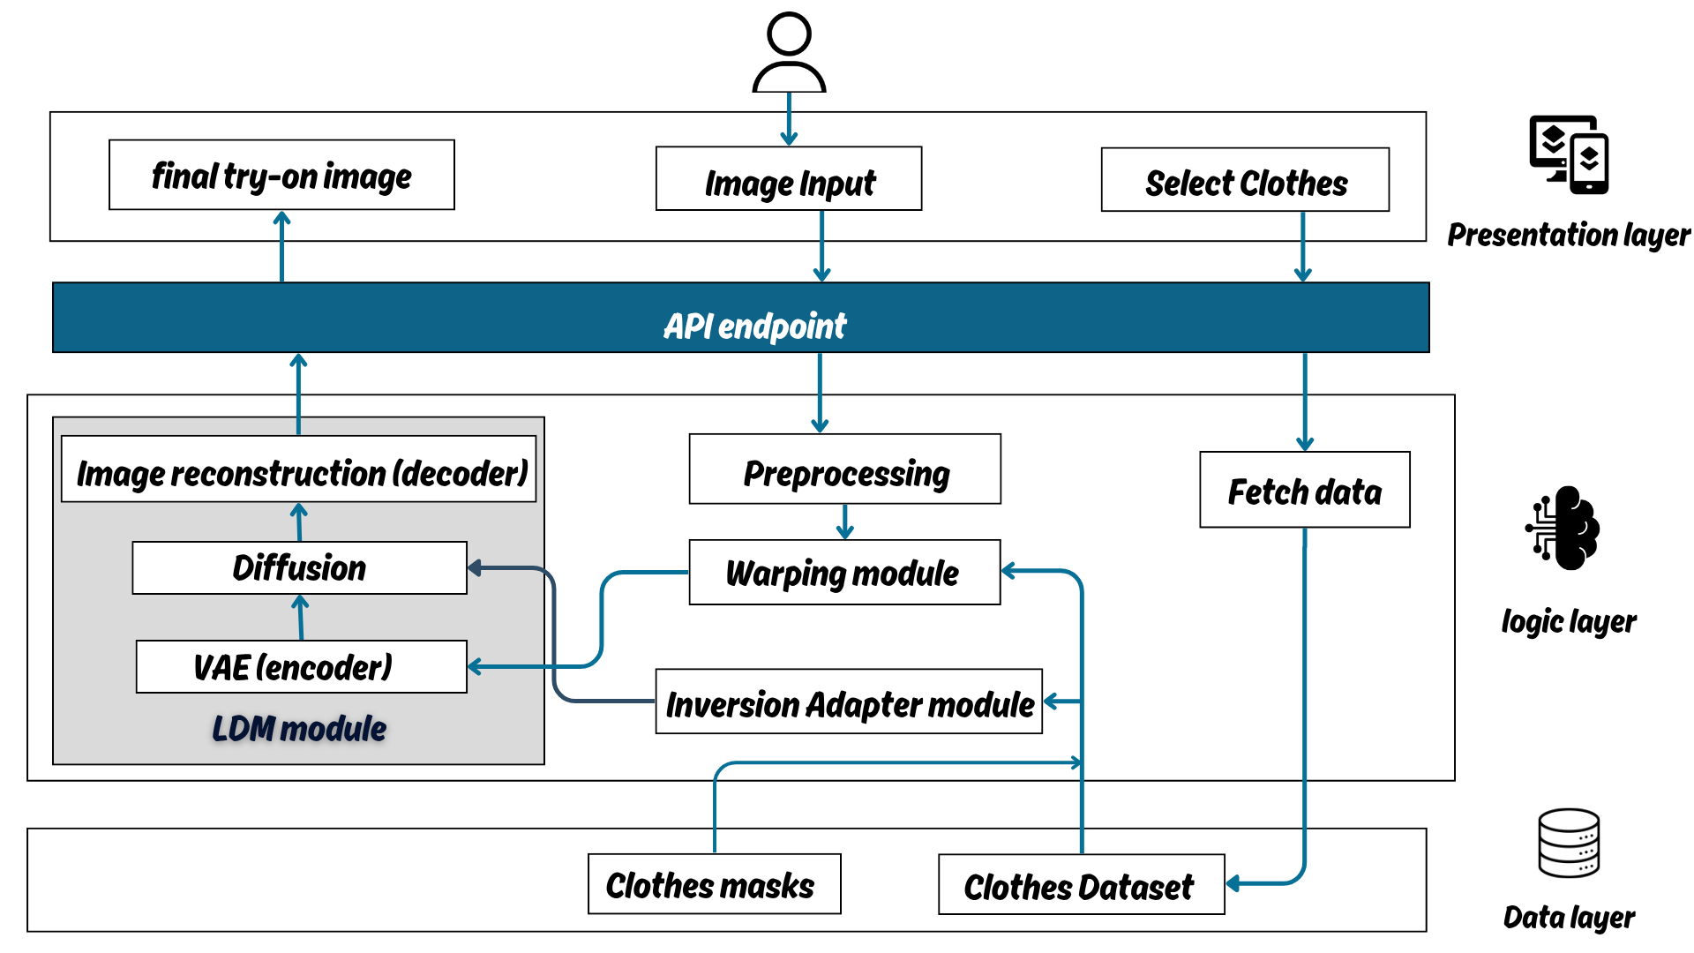

Slide 13
5- Dataset

Slide 14
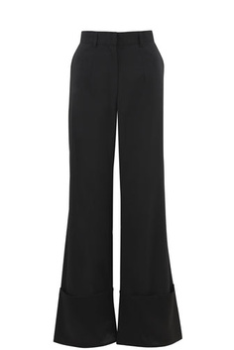
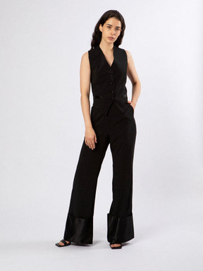
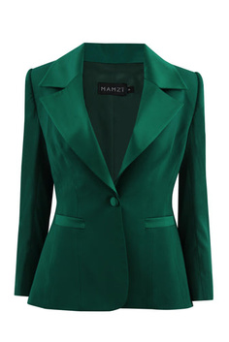
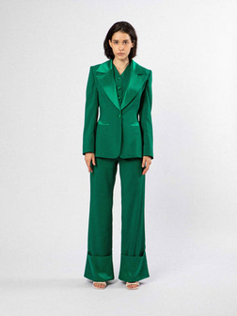
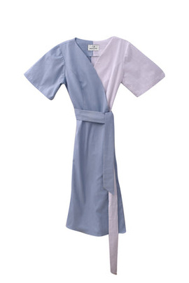
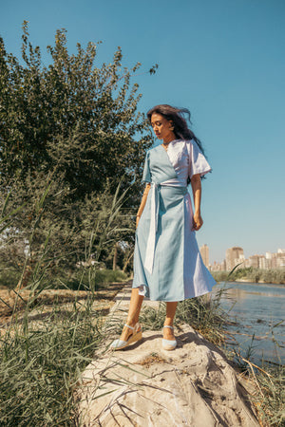
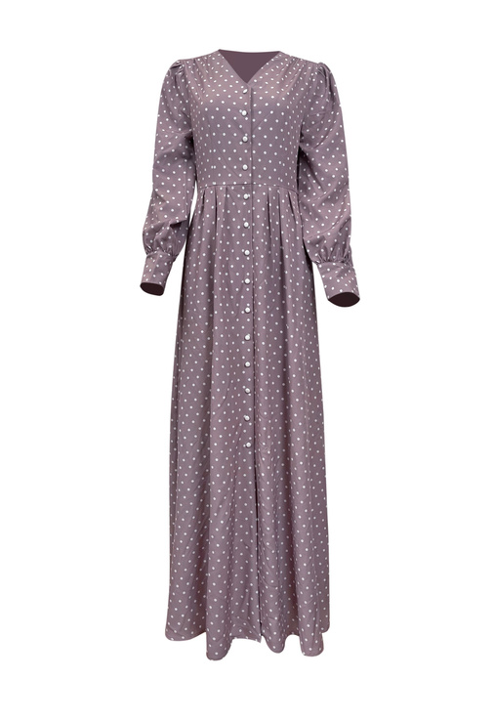
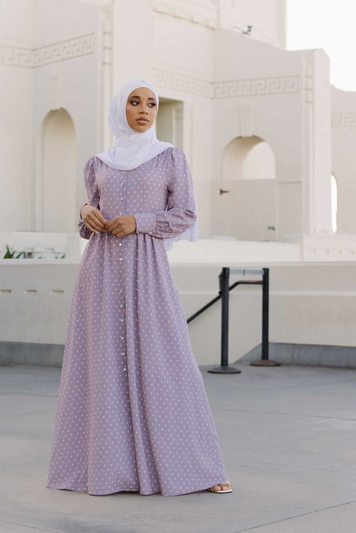
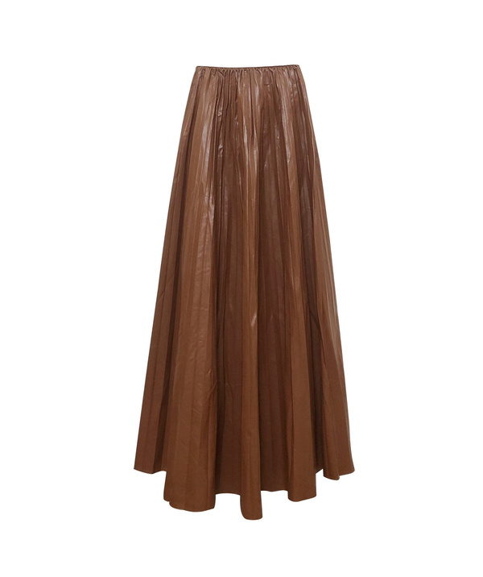
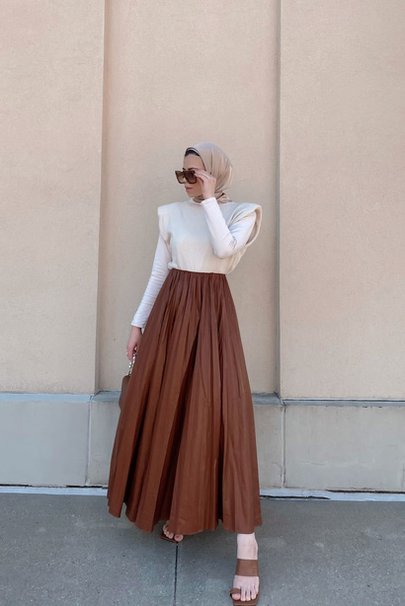
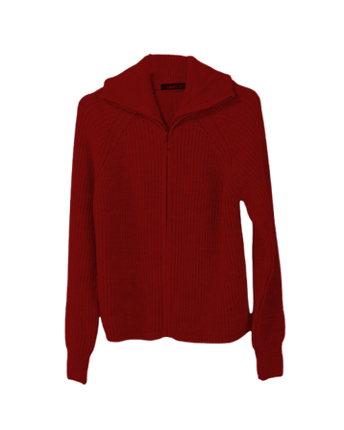
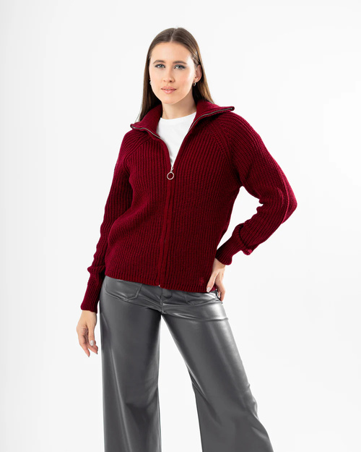
Data
Mamzi
Saqhoute
Niswa
What’s up

Slide 15
Description of Dataset
Name | Size | Description | Resource
TRYFIT Dataset | 41 pair images (FULL) 93 pair images (LOWER) 55 pair images (UPPER) | unveiled models | web scraping Local brands websites
TRYFIT Dataset | 141 pair images | veiled models | web scraping Local brands websites
TRYFIT Dataset | 399 pair images (FULL) 523 pair images (LOWER) 663 pair images (UPPER) | unveiled models | DressCode Dataset
TRYFIT Dataset | 1000 pair images (FULL) 865 pair images (UPPER) | unveiled models | Anchor Dataset

Slide 16
6- Phases Description

Slide 17
Presented by
PHASE 1
DATA PREPARATION MODELS

Slide 18
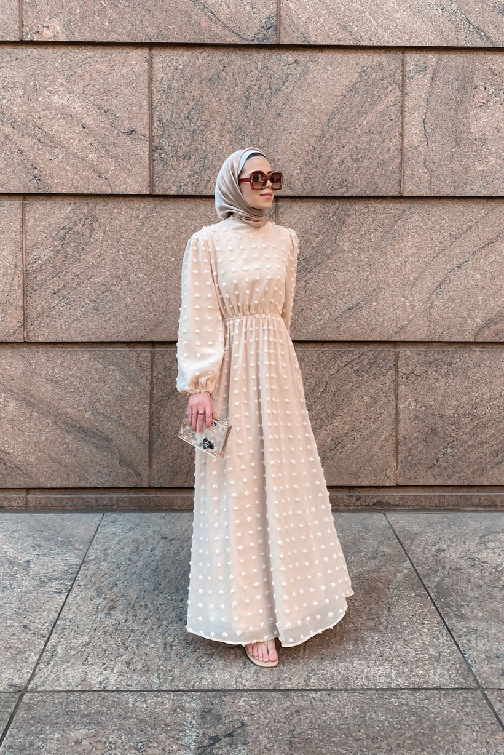
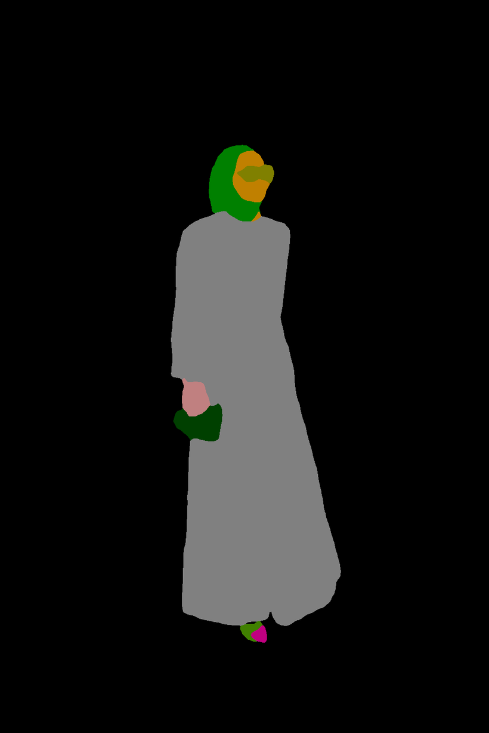
Segmentation
The model generates detailed human parsing maps that segment a person image into approximately 18 semantic regions (e.g., hair, face, upper clothes, pants, arms, and legs), which are then used to guide clothing warping and preserve identity-critical regions

Slide 19
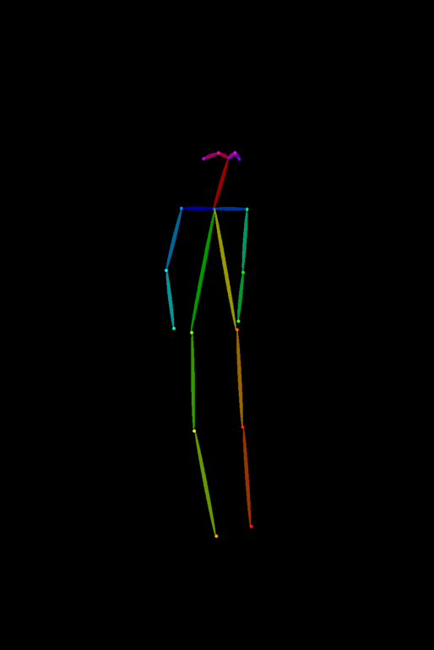
Skeleton and Keypoints
We use pose estimation to extract (KEYPOINTS) that represent human joints and form a skeleton of the body.
This skeleton captures the person's pose and body structure, guiding accurate cloth alignment and warping.

Slide 20
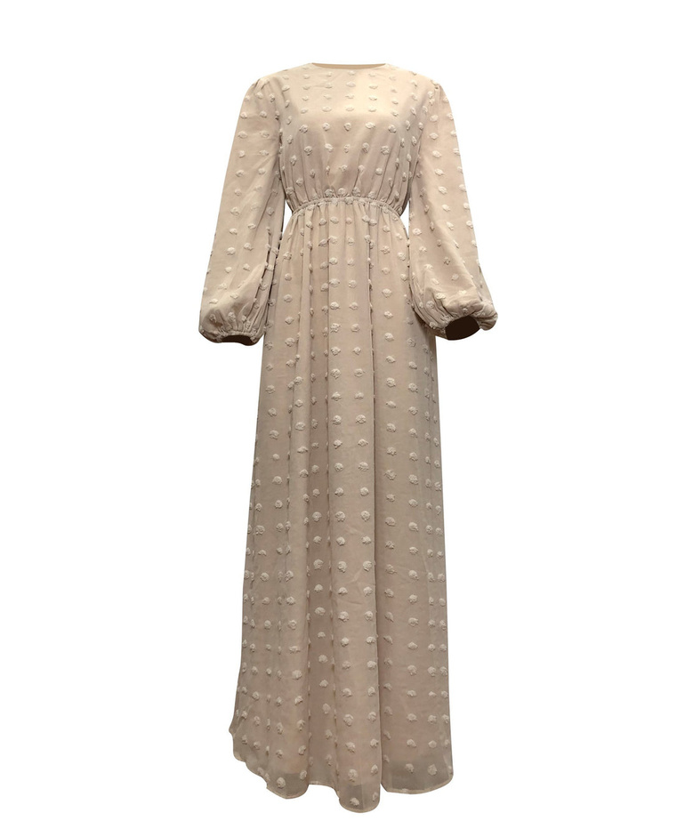
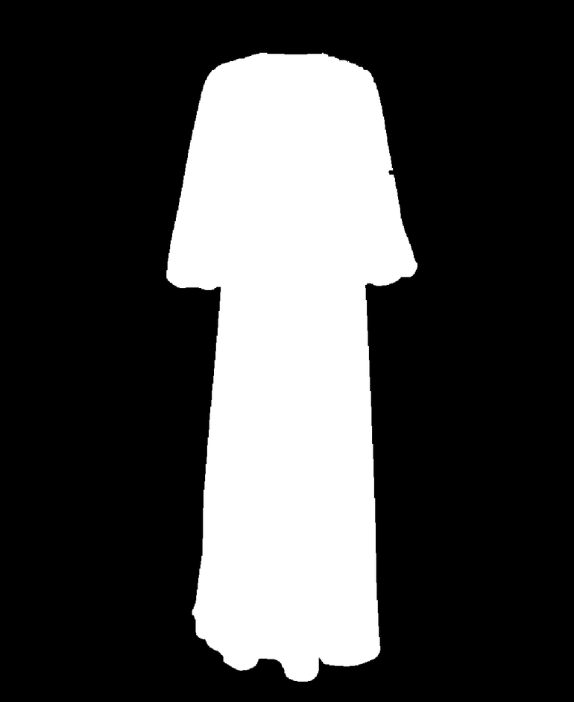
Cloth Masks
Generated by extracting clothing regions from the image, producing binary masks where clothing areas are marked as 1 and
non-clothing areas as 0
ensures accurate alignment and preservation of non-clothing regions

Slide 21
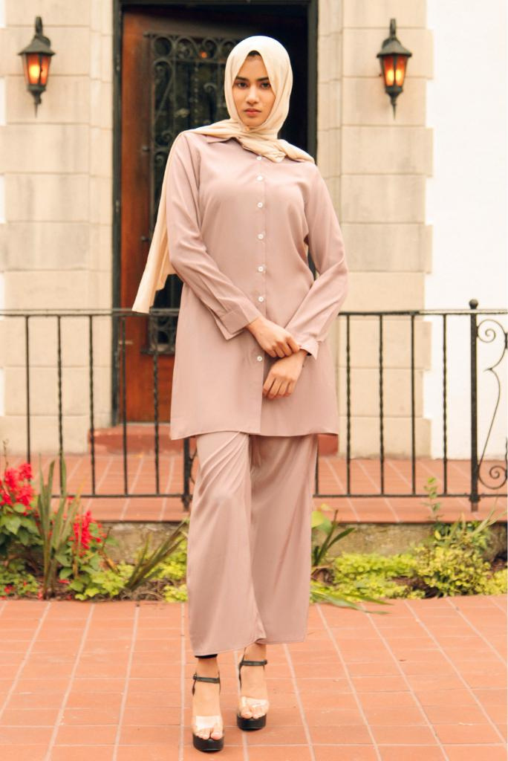
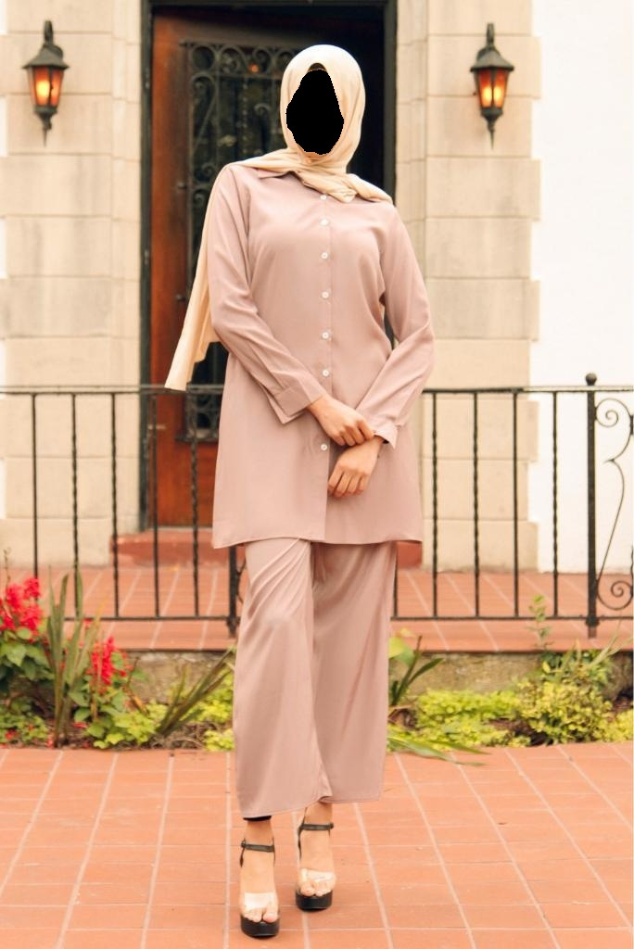
Face Masking
To reduce the model's focus on facial details and enhance attention on clothing, we applied a black face mask technique to the model image using its corresponding label map to localize the face region.

Slide 22
Presented by
PHASE 2
TRY-ON PIPELINE

Slide 23
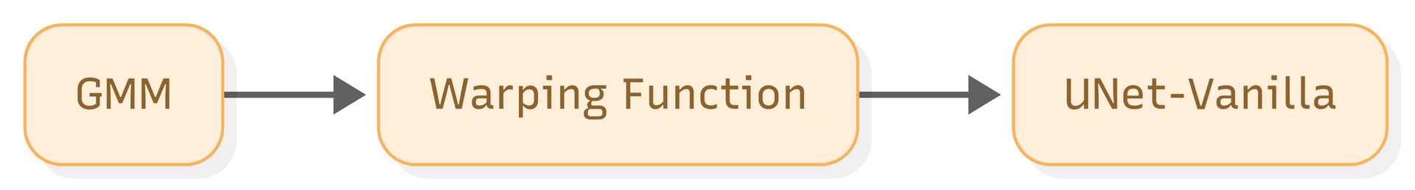
Warping module
-Warping module components serve as the essential first step
-Purpose : The Warping Module's job is to align the in-shop garment image with the body shape and pose of the target person. It ensures that the clothing looks like it naturally fits the person
-Warping Module components :

Slide 24
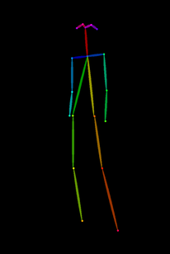
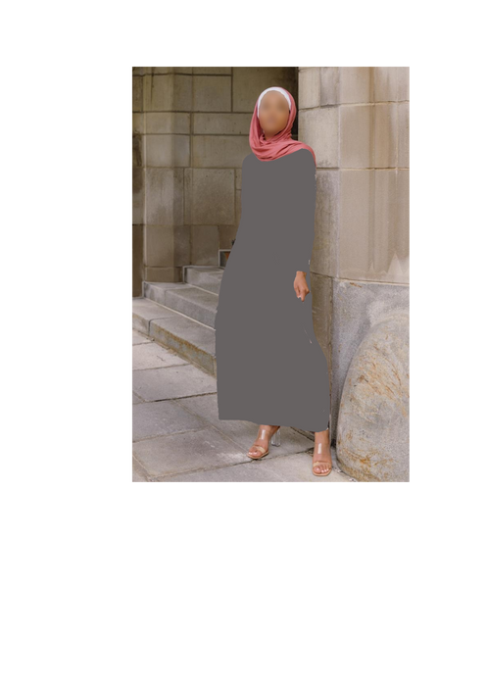
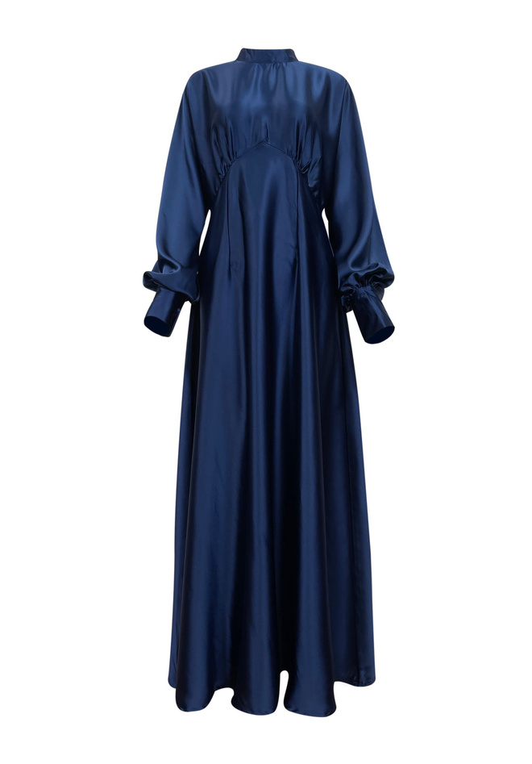
Warping module
1-Geometric Matching Module (GMM)
-Model : ConvNet_TPS — a convolutional network that predicts control-point
displacements through Thin-Plate Spline (TPS) which is a smooth, flexible
mathematical method for cloth warping.
Skeleton
Masked model
CNN model Features extraction
Correlation matrix
Control Points
Displacements
Tps Grid
CNN garment Features extraction
Cross Correlation
TPS Regression
TPS Grid generation
(TPS Parameters)
Garment image

Slide 25
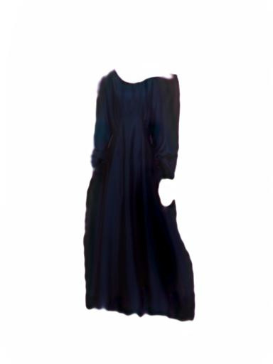

Warping module
2- Warping Function
[
[[(-1.0,-1.0), (-0.33,-1.0), (0.33,-1.0), (1.0,-1.0)],
[(-1.0,-0.33), ..., , (1.0,-0.33)],
[(-1.0,0.33), ..., , (1.0,0.33)],
[(-1.0,1.0), (0.33,1.0), (0.66,1.0), (1.0,1.0)]]
]
Tps Grid
Garment
Coarsely warped garment

Slide 26
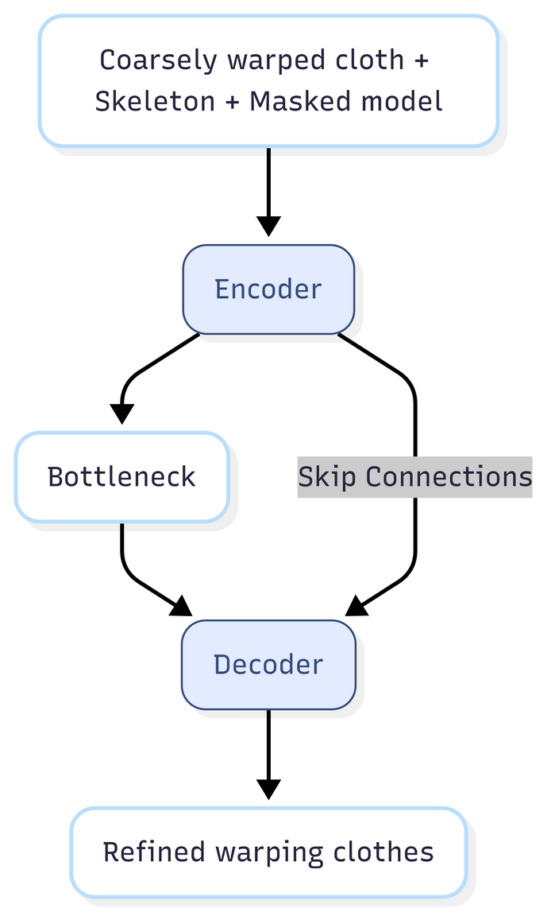
Warping module
3- UNet-Vanilla Refinement Network
-Purpose: Polishes coarse warped cloth output to enhance visual consistency and detail maintaining precise positioning while refining
-Key Components:
Encoder (Downsampling)
Skip Connections
Decoder (Upsampling)

Slide 27
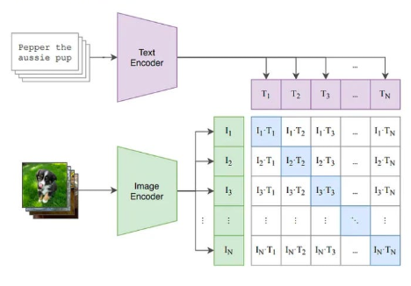
Inversion Adapter module
1- Vision Part Pipeline
(The Cloth Image)
2- Description part pipeline
(The Description)

Slide 28
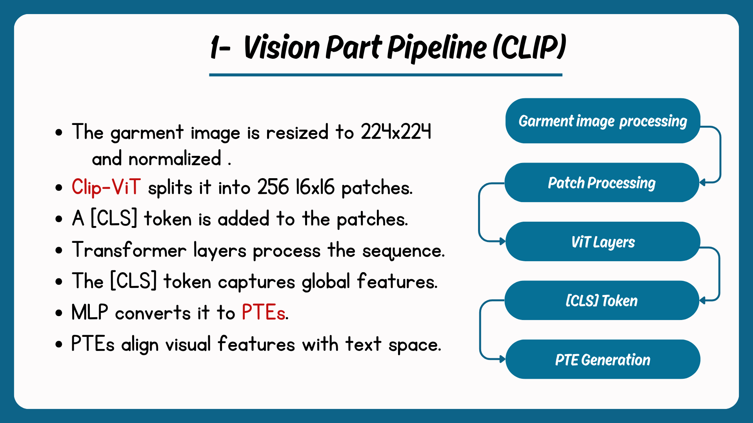

Slide 29
2- Description part pipeline
Text prompt with placeholders
(Ex: "A model wearing ... $ $ $ $ blue dress")
2.Tokenization
["a", "model", "wearing", ...,"$", "$", "$", "$", "a", "blue", "dress"]
Map to token IDs: [320, 3293, 2674, 259, 259, ...]
Pad to 77 tokens: [320, ..., 0,0]
Getting tensor of shape [1, 77]
Blue dress

Slide 30
2- Description part pipeline
3. Embedding Lookup
Each token ID → 768-dim vector
Ex : "a" (ID 320) → [0.2, -0.1, ..., 0.5]
Get input_embeddings tensor of shape [1, 77, 768]
4. PTE Injection
Replace $ embeddings (positions 4-7) with PTEs from vision
Blue dress

Slide 31
2- Description part pipeline
5. CLIP Text Encoder
Self-attention links PTEs to descriptive words (e.g., "blue").
Output: Conditioned_text_embeddings of shape
[1, 77, 768]
The Output of the module is Conditioned_text_embeddings
of shape [1, 77, 768] as 768-dim vector for each token

Slide 32
Token Position | Token Concept | Embedding vector (768)
0 | [SOS] | [0.2, -0.1, 0.5, ..., 0.3]
1 | “a” | [0.5, 0.0, -0.2, ..., 0.7]
2 | "model” | [0.1, -0.3, 0.4, ..., -0.5]
3 | "wearing” | [-0.2, 0.6, 0.1, ..., 0.4]
4-7 | PTE1-PTE4 | [0.8, -0.5, 0.9, ..., -0.3] (visual traits)
8 | "a” | [0.5, 0.0, -0.2, ..., 0.7]
9 | "blue” | [0.6, -0.4, 0.3, ..., 0.2]
10 | "dress” | [0.3, 0.1, -0.7, ..., 0.0]
1 1-76 | [PDA] | [0.0, 0.0, 0.0, ..., 0.0]
Conditioned
_text_
embeddings

Slide 33
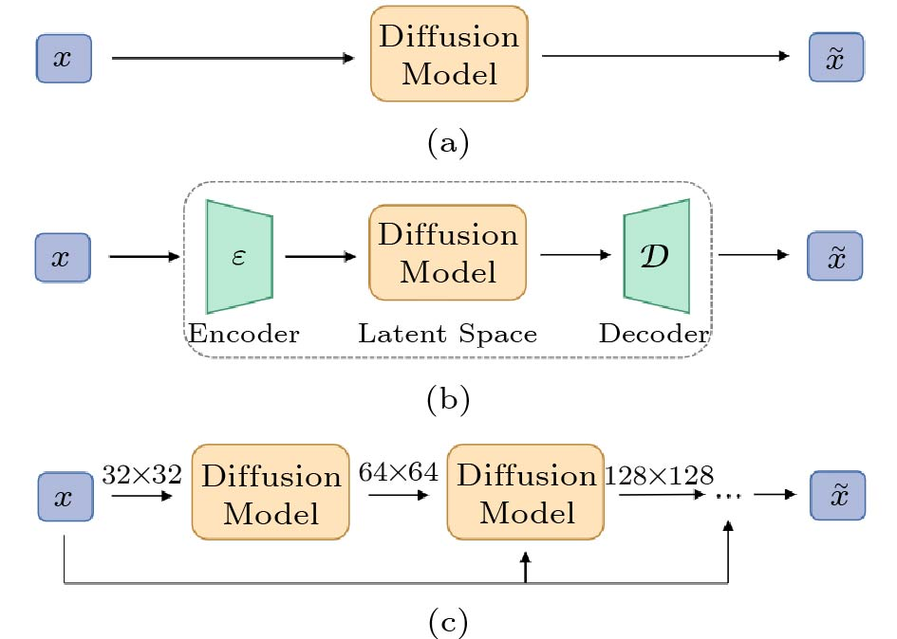
Latent diffusion module
Purpose
Generating photorealistic try-on results by blending warped garments with the target person's body.
Inputs
Warped clothe image
Target body
keypoints text embeddings
Label maps
Output
Final Try_on image

Slide 34
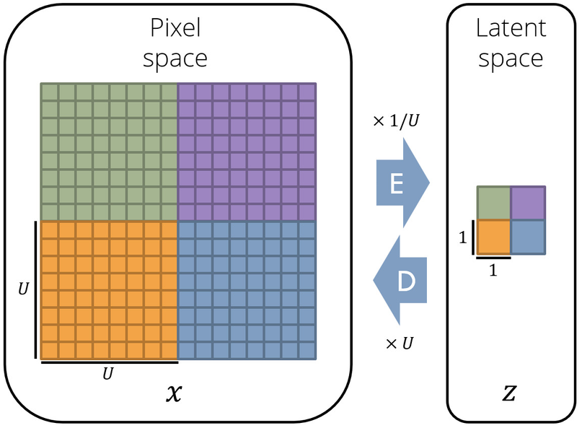
Latent diffusion module
operates in a compressed latent space via VAE
Latent space is a compressed, lower-dimensional representation of data in LDMs
Faster & lighter:
Uses 10–20x less memory by working in compressed space.
Cleaner results:
Focuses on key details by removing high-frequency noise

Slide 35
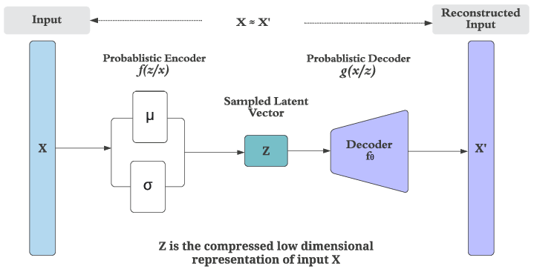
Variational autoencoder
VAE encodes high-dimensional data into a compact latent representation, reducing computational costs while preserving essential features.

Slide 36
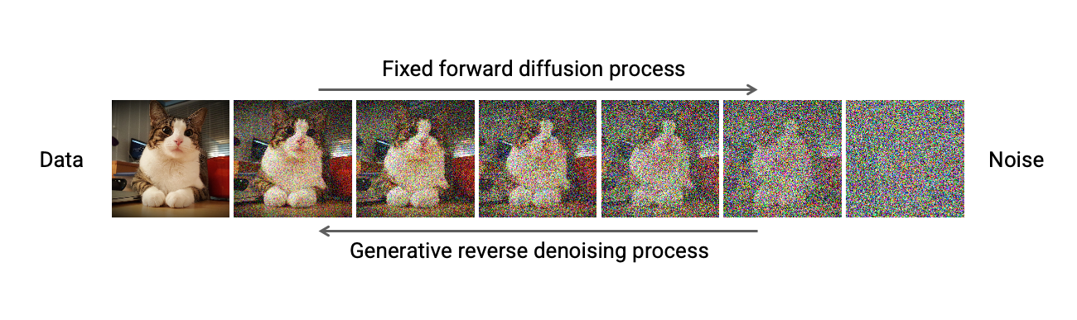
Diffusion
Diffusion models are generative models that produce realistic outputs, especially in image generation, by using a step-by-step noise removal process.
Forward Process: Gradually add noise to an image until it becomes pure noise
Reverse Process: Train a model to denoise step-by-step, reconstructing the original image.

Slide 37
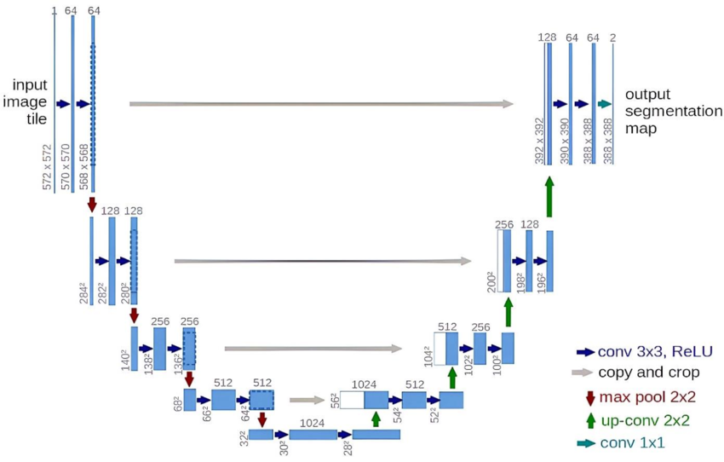
UNet (Denoising phase )
U-Net: The Noise-Predicting Workhorse
Predicts noise ε at each denoising step

Slide 38
UNet (Denoising phase )
The fusion happens inside the U-Net during denoising
warped cloth
Target body
segmented parts
keypoints
text embeddings
Fusion process where multiple inputs are integrated to generate a realistic, pose-aligned, and semantically accurate try-on image.

Slide 39
EMASC
Enhanced mask aware skip connections works on the skip connections of the U-Net used for denoising.
Improves skip connections
Uses segmentation mask
Works at different scales to handle both small and big parts of the clothes
Fixes misalignment
Enhances detail and accuracy

Slide 40
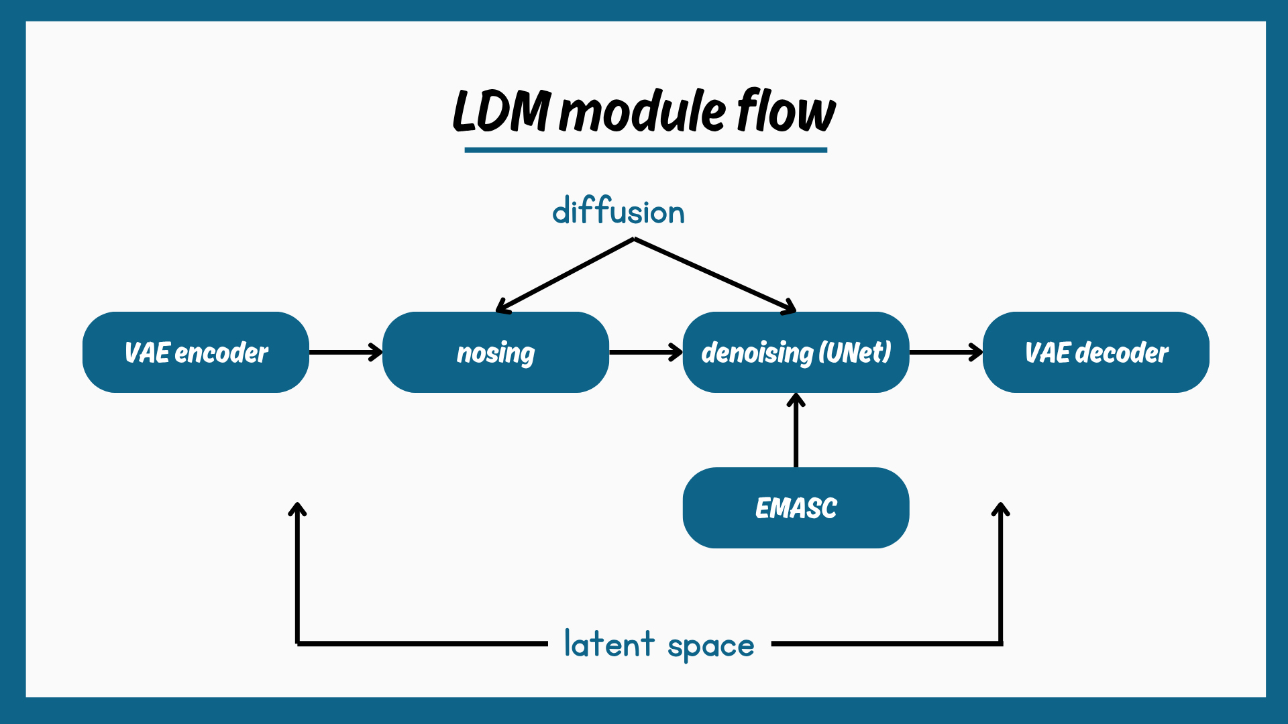

Slide 41
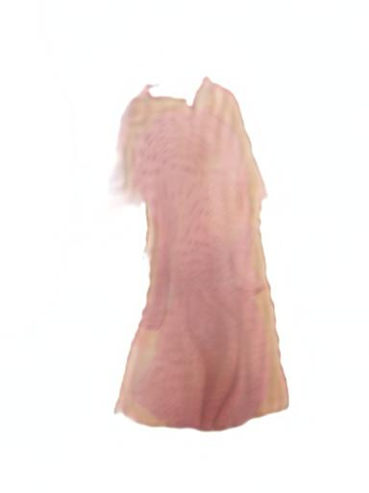
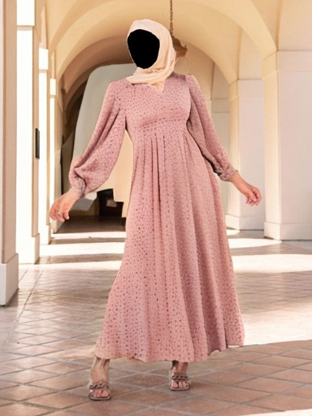
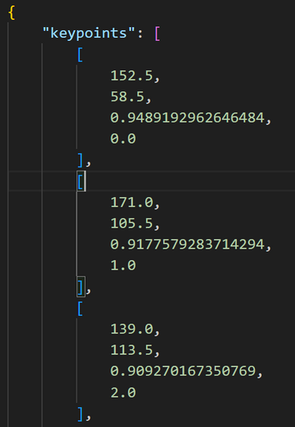
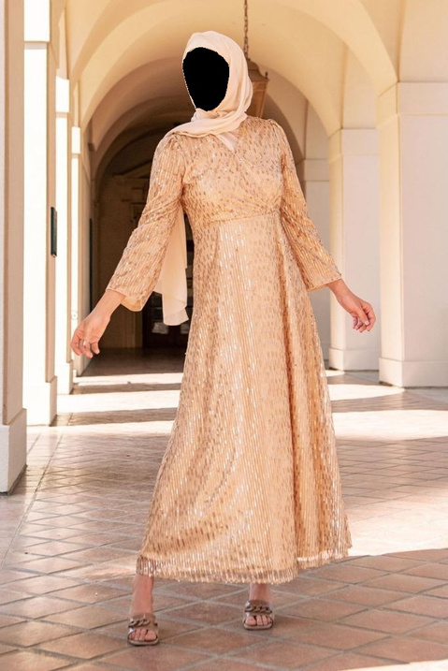
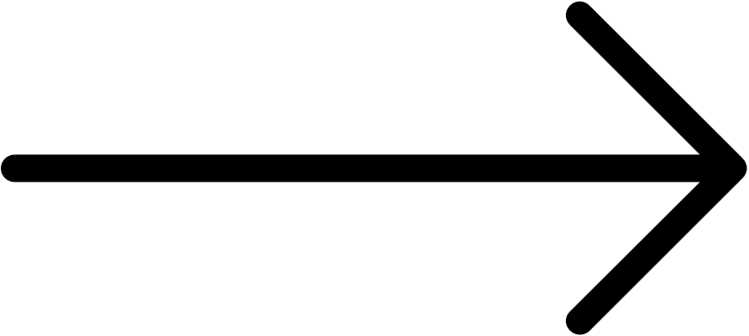
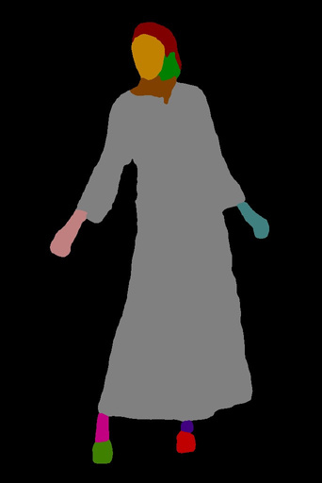
Image reconstruction
[1,77,768]
CLIP text embedding

Slide 42
7- Experiments and Results

Slide 43
Selected Try Fit Training Data
Dataset 1: 706 pairs of images / 121 veiled pairs
Dataset 2: 586 pairs of images / 10 veiled pairs
Dataset 3: 1274 pairs of images / 130 veiled pairs
Dataset 4: 1912 pairs of images

Slide 44
Evaluation Metrics Used
LPIPS (Learned Perceptual Image Patch Similarity) ↓ | FID (Fréchet Inception Distance) ↓ | SSIM (Structural Similarity Index Measure) ↑
Computes a distance based on deep features between a generated try-on image and the real (ground-truth) try-on image. | Measures how realistic and globally convincing and varied the generated image compared to real images | Pixel-level structural similarity (luminance, contrast, structure).
Together, LPIPS, SSIM and FID provide a complete evaluation. This balance helps assess both fidelity and visual quality in virtual try-on results. | Together, LPIPS, SSIM and FID provide a complete evaluation. This balance helps assess both fidelity and visual quality in virtual try-on results. | Together, LPIPS, SSIM and FID provide a complete evaluation. This balance helps assess both fidelity and visual quality in virtual try-on results.

Slide 45
TRIALS

Slide 46
# | Dataset | EMASC steps | TPS epochs | refinement epochs | Inversion Adaptor | descriptions | Hyper parameter tuning | FID ↓ | LPIPS↓
1 | dataset 1 | 2000 | 5 | 5 | _ | _ | _ | 111.35 | 0.24
2 | dataset 1 | 3000 | 5 | 5 | _ | _ | _ | 78.49 | 0.147
3 | dataset 2 | 3000 | 30 | 30 | _ | _ | _ | 103.22 | 0.147
4 | dataset 3 | 5000 | 50 | 50 | ✔ | _ | _ | 53.577 | 0.142
5 | dataset 3 | 7000 | 50 | 50 | ✔ | _ | ✔ | 53.283 | 0.140
6 | dataset 4 | 7000 | 75 | 75 | ✔ | ✔ | ✔ | 57.219 | 0.168
7 | dataset 4 | 7000 | 70 | 70 | ✔ | ✔ | ✔ | 59.249 | 0.169
8 | dataset 4 | 7000 | 70 | 70 | ✔ | _ | ✔ | 57.62 | 0.168

Slide 47
Final Result
 | SSIM FID
Try Fit model | 0.86825 53.2839
ladi model | 0.84894 58.3535

Slide 48
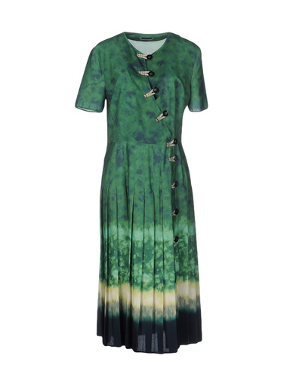
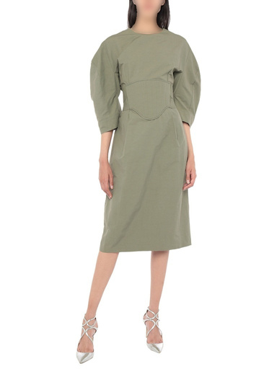









Dresses Visual Results
Garment Body Trial_1 Trial_2 Trial_4 Trial_5

Slide 49












Dresses Visual Results
Garment Body Trial_1 Trial_2 Trial_4 Trial_5

Slide 50












Upper body Visual Results
Garment Body Trial_1 Trial_2 Trial_4 Trial_5

Slide 51











Lower body Visual Results
Garment Body Trial_1 Trial_2 Trial_4 Trial_5

Slide 52
8- Demo

Slide 53



Slide 54
9- Conclusion and Future Work

Slide 55
Future Work
Presented by
Multi-Layer Try-On
Recommendation System: Suggest items based on user preferences, wishlists, and previous try-ons to boost engagement.
Size Recommendation
Color Customization
Expanding Hijab & Modest Fashion Dataset

Slide 56
Conclusion
Presented by
✅ We developed TryFit, a culturally inclusive Virtual Try-On system
tailored for modest fashion and veiled users.
🧠 Integrated advanced deep learning models CLIP, TPS
and EMASC to ensure realism.
📱 Built with a modular architecture using FlutterFlow, Firebase and Flask
for seamless user experience and backend processing.
👗 Supports upper, lower, full-body garments — including hijabs — with
high-quality try-on results.

Slide 57


Slide 58
10- References

Slide 59
[1] D. Morelli, A. Baldrati, G. Cartella, M. Cornia, M. Bertini, and R. Cucchiara, “LaDI-VTON: Latent Diffusion Textual-Inversion Enhanced Virtual Try-On,” Oct. 2023, doi: https://doi.org/10.1145/3581783.3612137.
[2] Z. Chong et al., “CatVTON: Concatenation Is All You Need for Virtual Try-On with Diffusion Models,” arXiv.org, 2024. https://arxiv.org/abs/2407.15886.
[3] S. Choi, S. Park, M. Lee, and J. Choo, “VITON-HD: High-Resolution Virtual Try-On via Misalignment-Aware Normalization.” Accessed: Jun. 11, 2025. https://openaccess.thecvf.com/content/CVPR2021/papers/Choi_VITON-HD_High-Resolution_Virtual_Try-On_via_Misalignment-Aware_Normalization_CVPR_2021_paper.pdf.
[4] Y. Choi, S. Kwak, K. Lee, H. Choi, and J. Shin, “Improving Diffusion Models for Authentic Virtual Try-on in the Wild,” Lecture Notes in Computer Science, pp. 206–235, Oct. 2024, doi: https://doi.org/10.1007/978-3-031-73016-0_13.

Slide 60

THANK YOU

